Slide 1

EEE 2123 - Electronics
Noman Asif Aditya
Lecturer, Department of Computer Science and Engineering
United International University

Slide 2
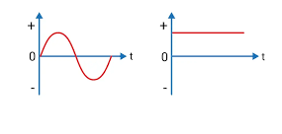
Rectification
Converting an AC voltage or current signal to a corresponding DC signal.
Where is it used?

Slide 3
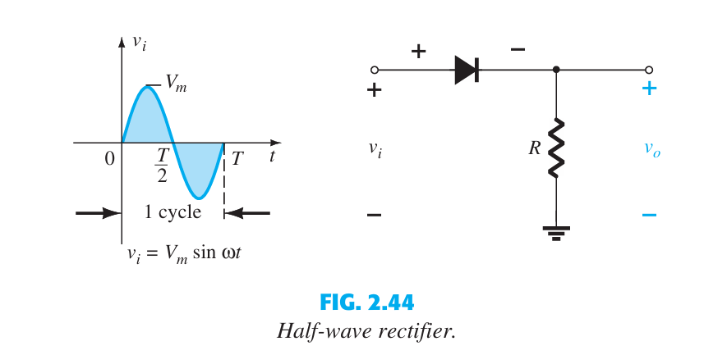
Half Wave Rectification
Courtesy: Electronic devices and Circuit Theory, Bolyestead.

Slide 4
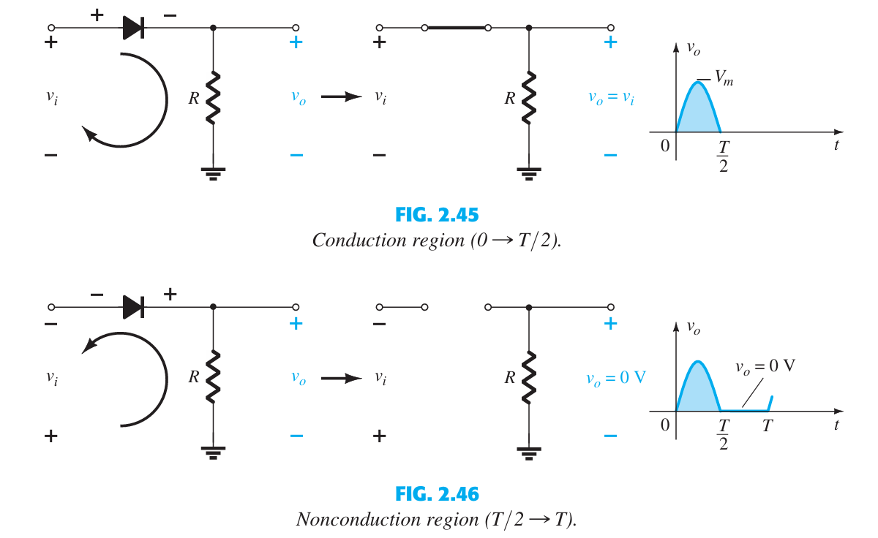
Half Wave Rectification
Courtesy: Electronic devices and Circuit Theory, Bolyestead.

Slide 5
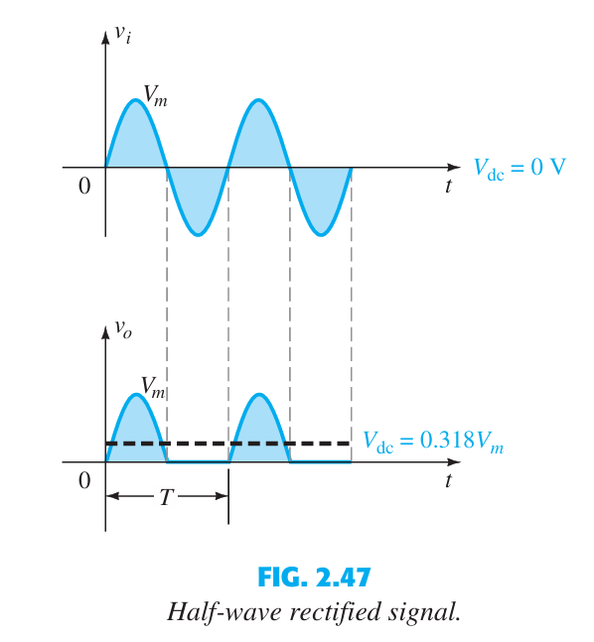

Half Wave Rectification
Average of the Output Voltage:
Courtesy: Electronic devices and Circuit Theory, Bolyestead.

Slide 6
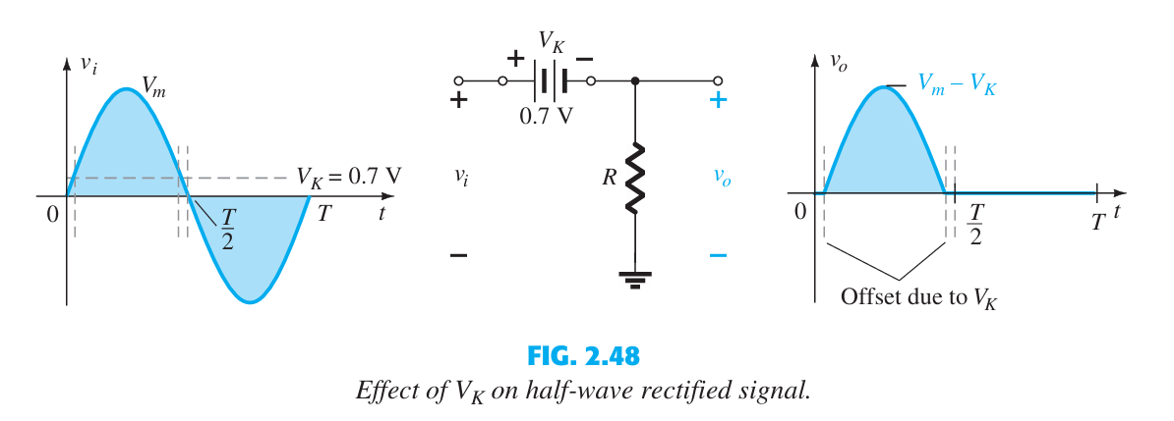

Half Wave Rectification (with Si diode)
Average of the Output Voltage:
Courtesy: Electronic devices and Circuit Theory, Bolyestead.

Slide 7
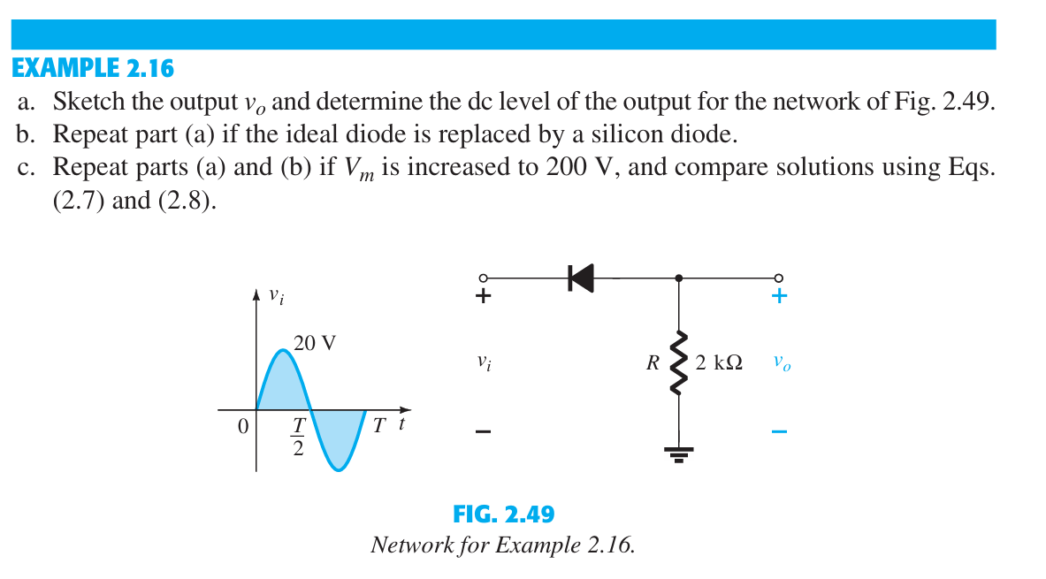
Example
Courtesy: Electronic devices and Circuit Theory, Bolyestead.

Slide 8
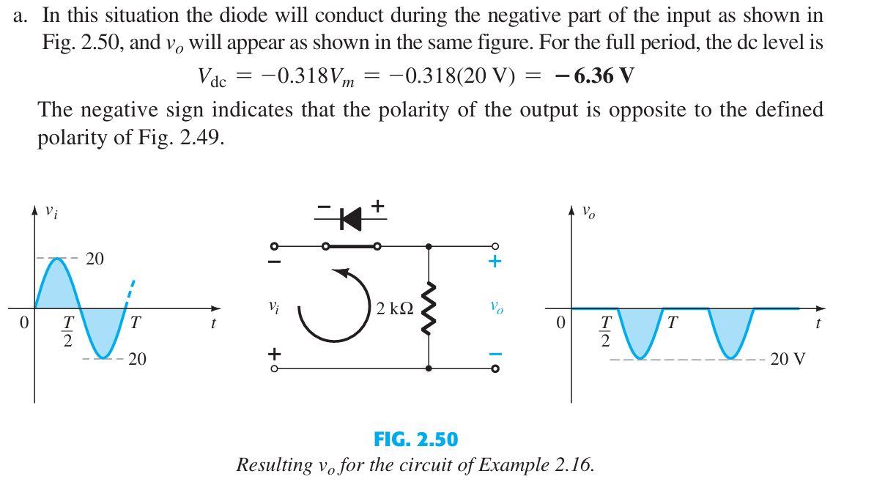
Solution
Courtesy: Electronic devices and Circuit Theory, Bolyestead.

Slide 9
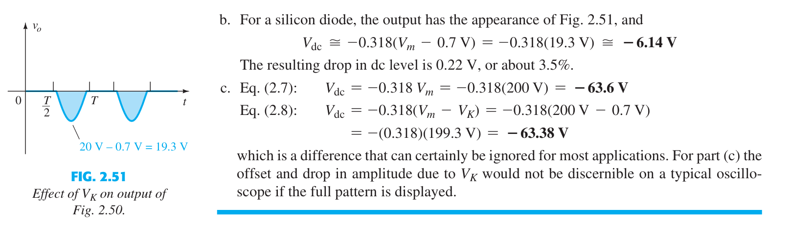
Solution
Courtesy: Electronic devices and Circuit Theory, Bolyestead.

Slide 10
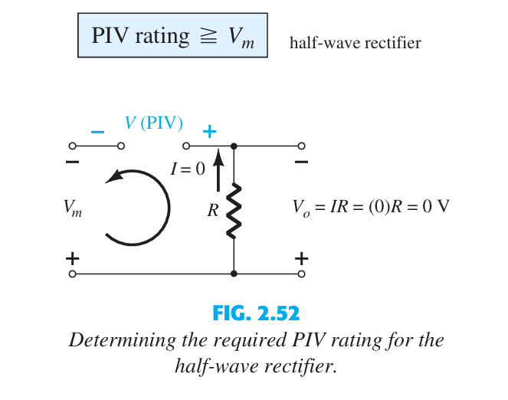
PIV (PRV)
The peak inverse voltage (PIV) [or PRV (peak reverse voltage)] rating of the diode is of primary importance in the design of rectification systems. Recall that it is the voltage rat ing that must not be exceeded in the reverse-bias region or the diode will enter the Zener avalanche region.
Courtesy: Electronic devices and Circuit Theory, Bolyestead.

Slide 11
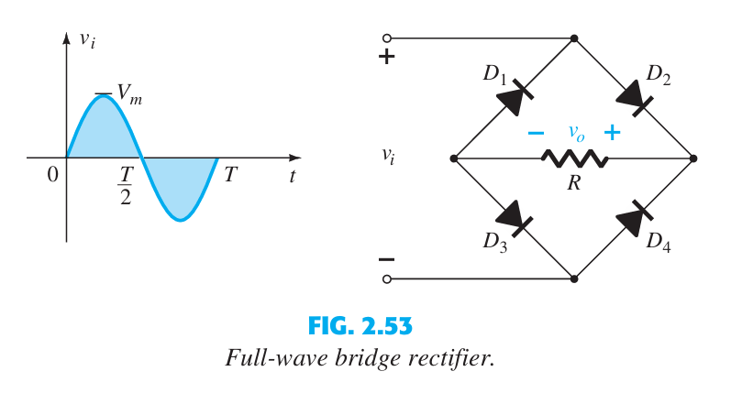
Full Wave Bridge Rectification
Courtesy: Electronic devices and Circuit Theory, Bolyestead.

Slide 12
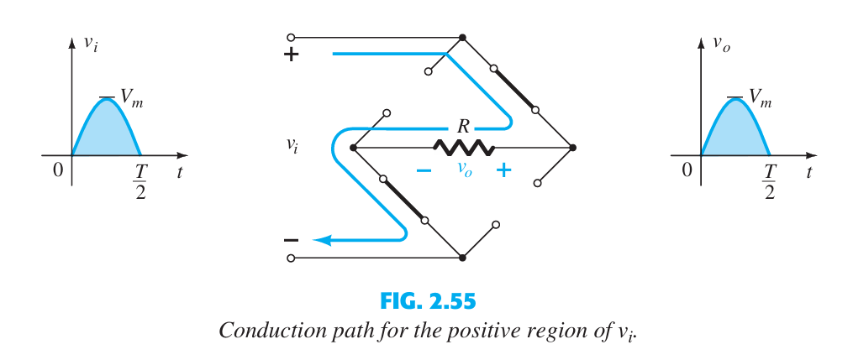
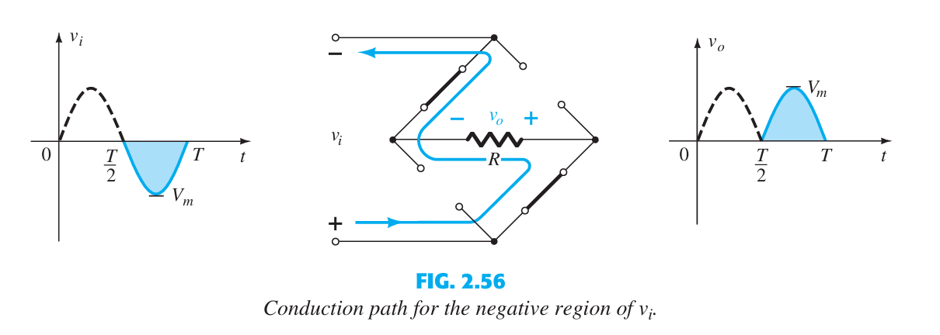
Full Wave Bridge Rectification
Courtesy: Electronic devices and Circuit Theory, Bolyestead.

Slide 13
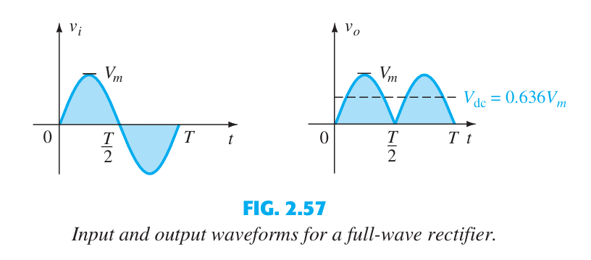

Full Wave Bridge Rectification
Courtesy: Electronic devices and Circuit Theory, Bolyestead.

Slide 14
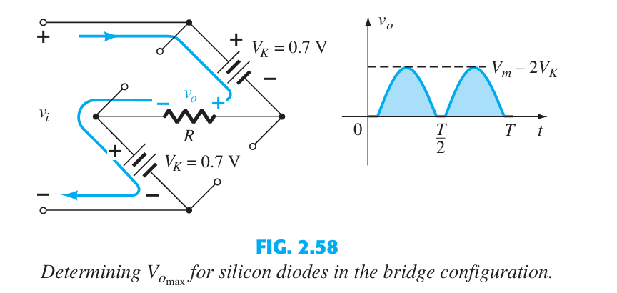

Full Wave Bridge Rectification(with Si diode)
Courtesy: Electronic devices and Circuit Theory, Bolyestead.

Slide 15
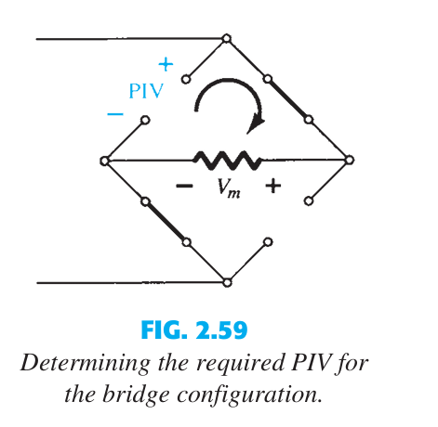

PIV for Full Wave Bridge Rectification
Determine PIV if Si diode is used.
Courtesy: Electronic devices and Circuit Theory, Bolyestead.

Slide 16
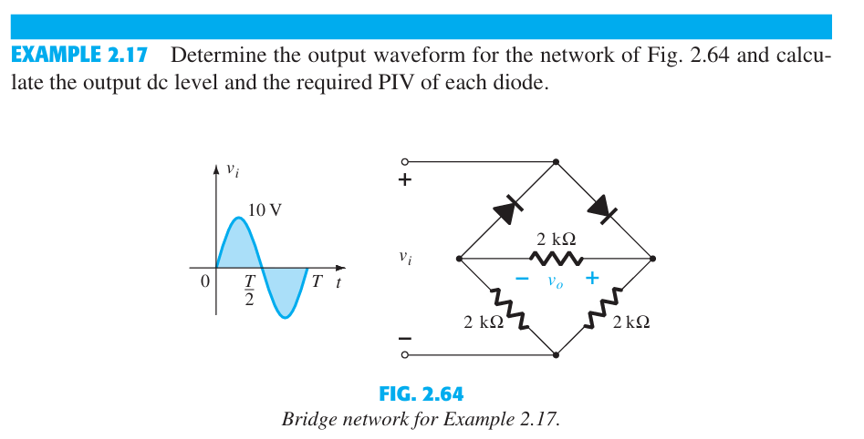
Example
Courtesy: Electronic devices and Circuit Theory, Bolyestead.

Slide 17
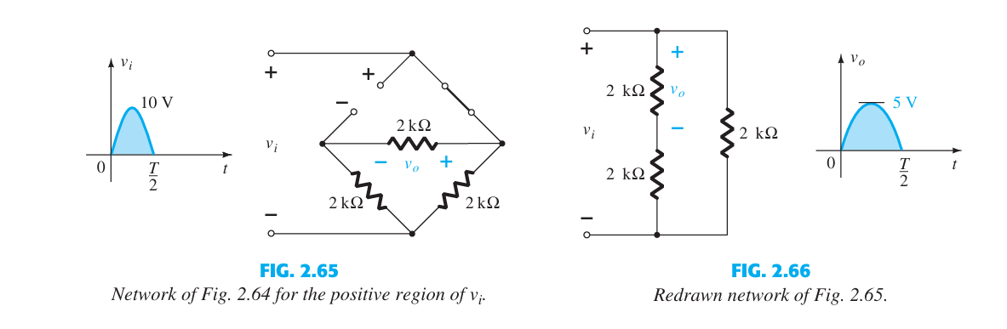
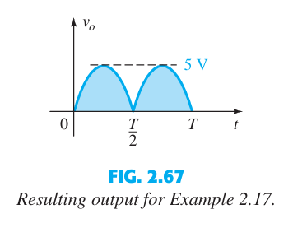
Example
Courtesy: Electronic devices and Circuit Theory, Bolyestead.

Slide 18
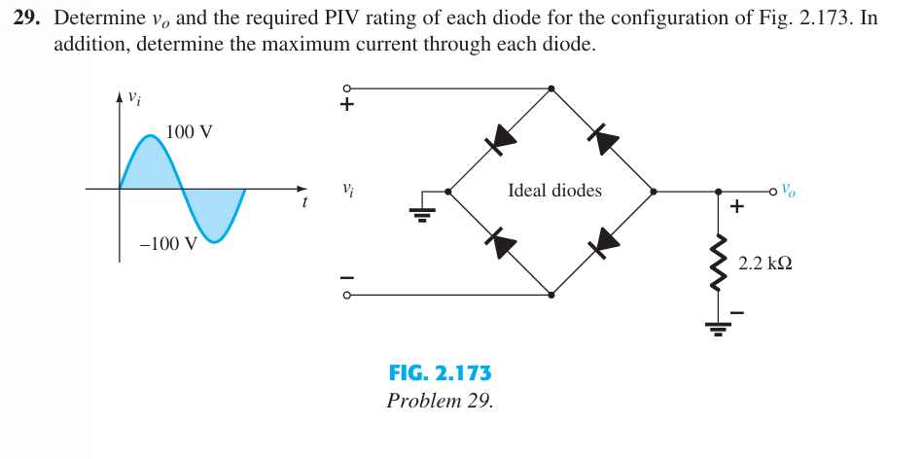
Exercise
Courtesy: Electronic devices and Circuit Theory, Bolyestead.

Slide 19
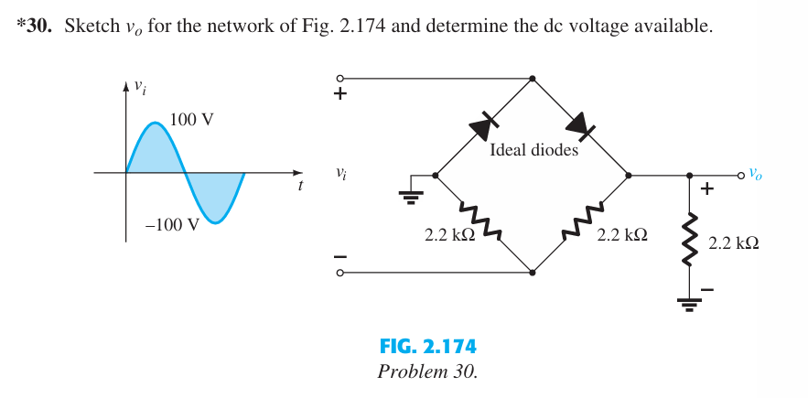
Exercise
Courtesy: Electronic devices and Circuit Theory, Bolyestead.

Slide 20
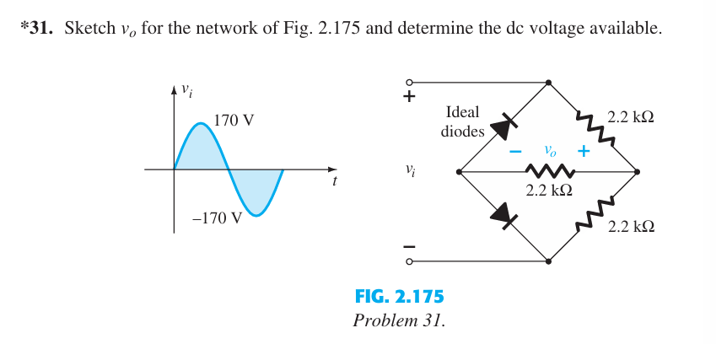
Exercise
Courtesy: Electronic devices and Circuit Theory, Bolyestead.

Slide 21

Thank you

